Slide 1
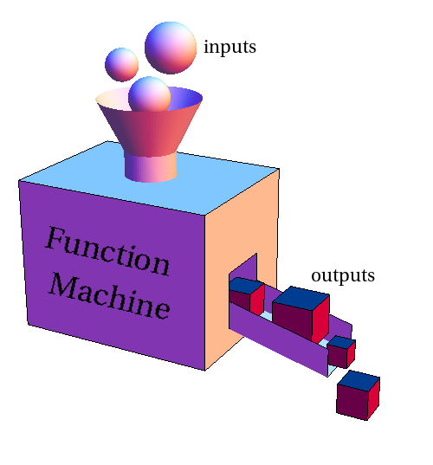
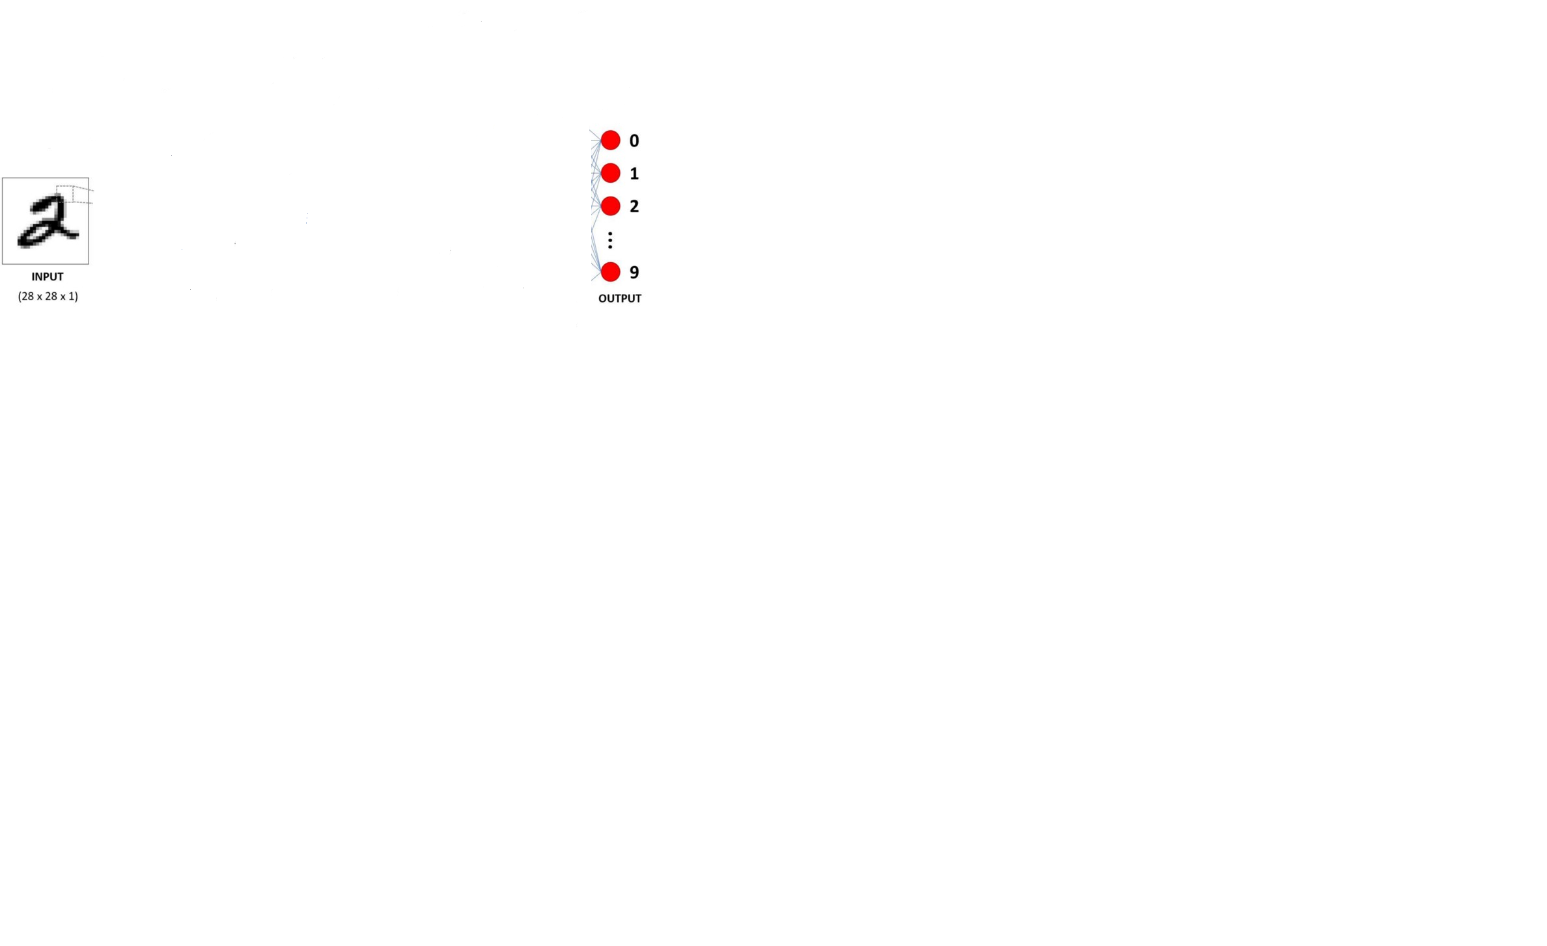
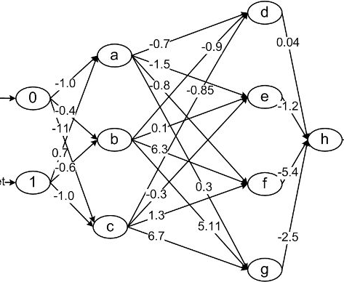
Neural Network is a function machine
Voice
Text
Video
Objects
טקסט בעברית
English Text
Text
Sentiment
Size, location, floor…
House Price

Slide 2
Neural Network is a function machine

Slide 3
Neural Network is a function machine

Slide 4
Neural Network
Neural
Network

Slide 5
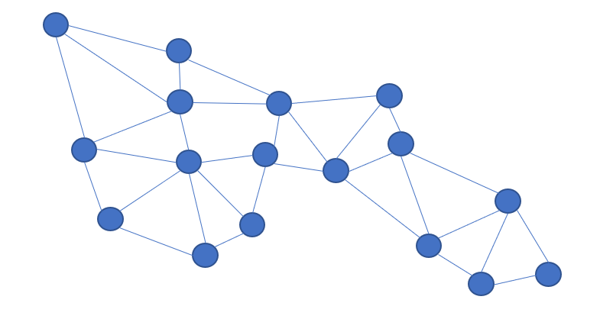
Network
What is a Network?
How can it provide answers?

Slide 6

Network
V1 affects V2
Edge
Vertex V1
Vertex V2
In math: v2 = f(v1)

Slide 7
Network
For Example:
V1 = X
V2 = W*X
V2
V1 affects V2
X
W
W*X
Edge
Vertex V1
Vertex V2
V1
In math: v2 = f(v1)

Slide 8
Adding Bias
V2
1
B
V1 = X
V2 = W*X + B
X
W
W*X+B
B
Edge
Vertex V1
Vertex V2
V1

Slide 9

Network solution for linear regression
A flat in the ground floor costs 100K
For each floor there is an addition of 10K
Solution: Price = 100K + 10K * floor
1
100K
B
X
10K
W
P

Slide 10
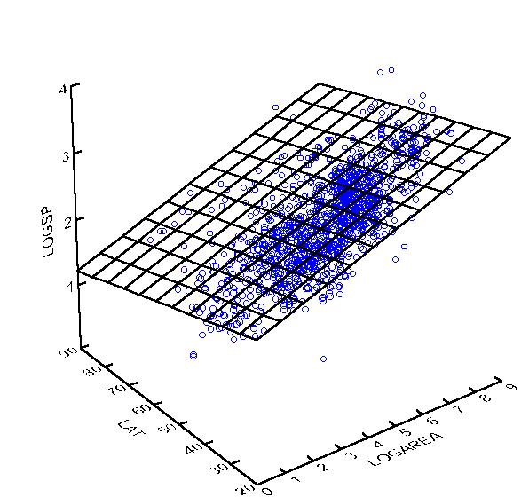
Network #2 – Multiple Linear Regression
2 input variables
Y = B + x1*w1 + x2*w2
1
B
X1
w1
Y
n input variables
Y = B + x1*w1 + x2*w2 + ... + xn* Wn
Y = B + Σ xi* wi
w2
X2
w3
X3
wn
Find the Weights
Xn

Slide 11

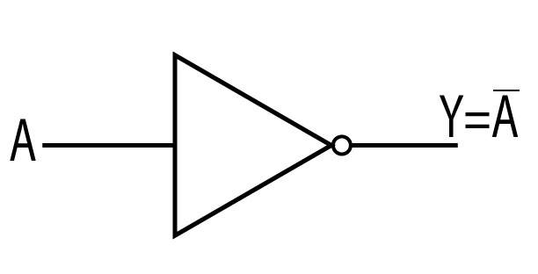


Categorial problem – The agreement
Ganz depends on Bibi
If Bibi is the PM -> Ganz is not the PM
If Bibi is not the PM -> Ganz is the PM
Let’s define that being the PM gets the value of 1, otherwise 0
1
B = ?
X
W = ?
PM
$$xε\left[0,1\right]$$
$$yε\left[0,1\right]$$
Solution: B = 1 , W = -1

Slide 12
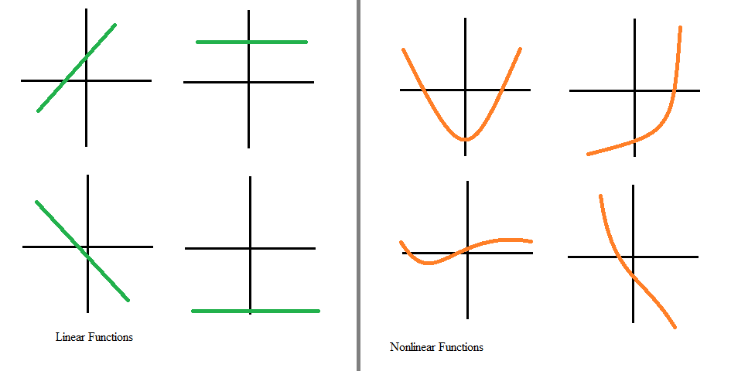
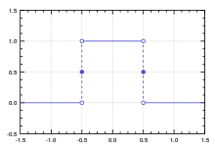
What about non-linear functions?

Slide 13
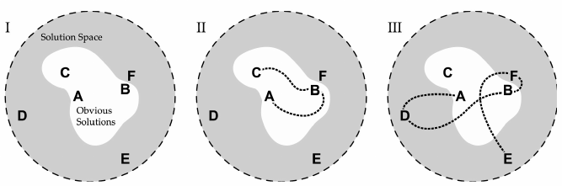
Solution Space

Slide 14

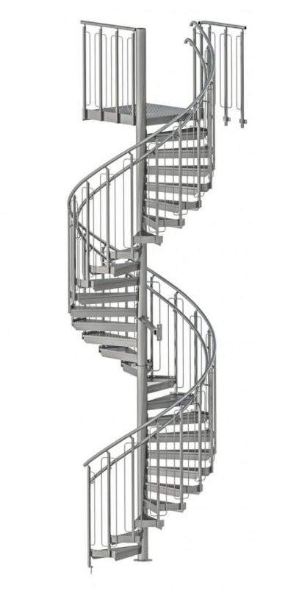



Non Linear solution space

Slide 15
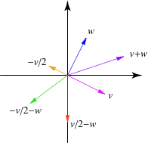
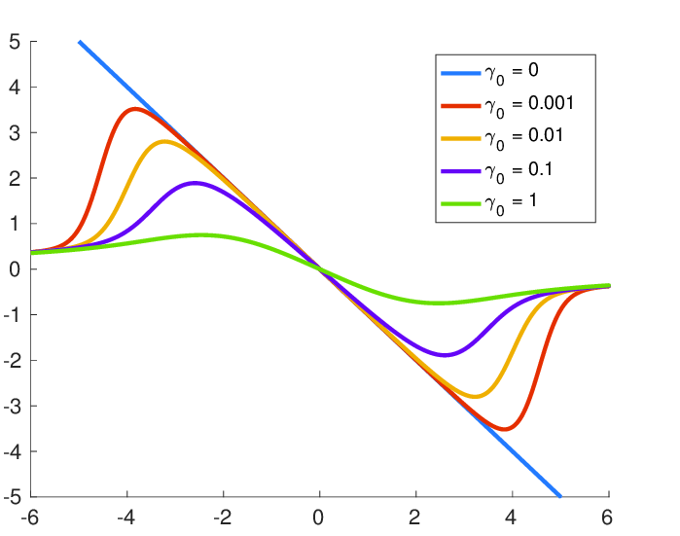
Solution space

Slide 16
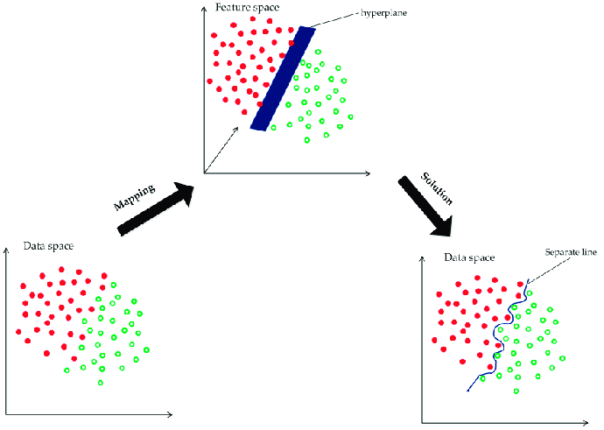
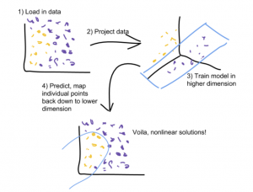
Non Linear solution

Slide 17
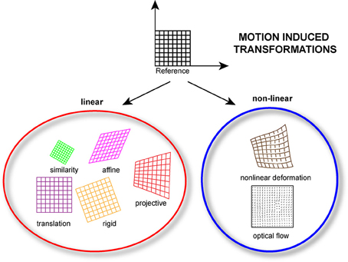
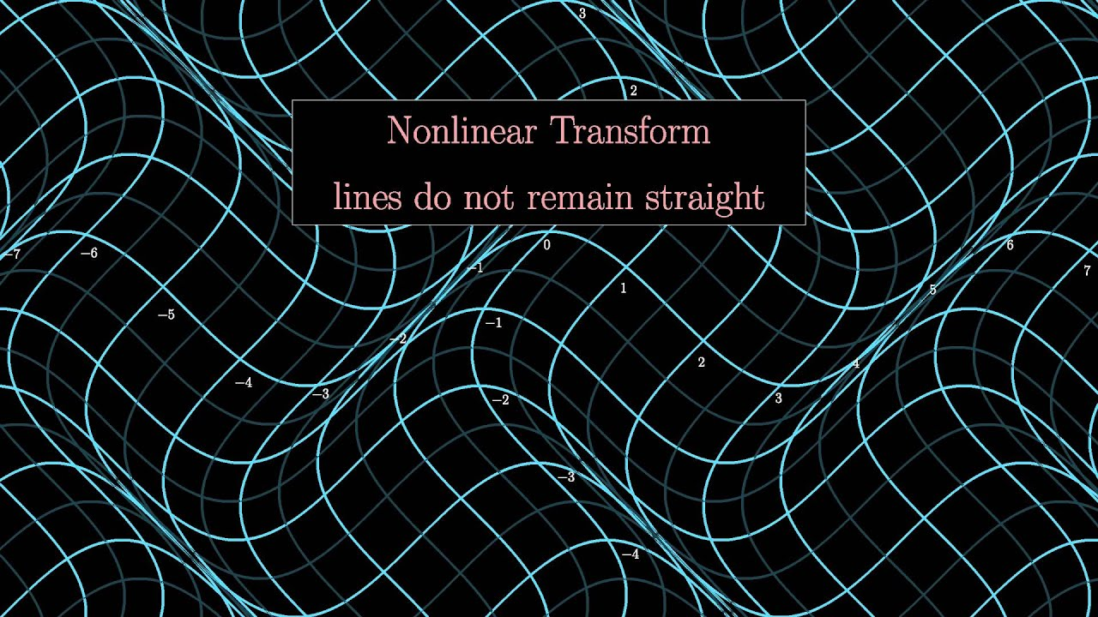
Solution space

Slide 18

Take home message
A Neural Network can be viewed as a function that maps input to output. The goal is to find this function.
A network is a set of nodes and edges. The nodes interact through the edges.
We can view Linear Regression and the NOT operator as a simple linear network.
Using only linear functions provides a limited solution space.

